Slide 1

FEDERAL REPUBLIC OF NIGERIA • THE PRESIDENCY
PROPOSAL FOR THE ESTABLISHMENT OF THE
Office of Defence Strategy,
Security Cooperation &
International Defence Partnerships
A Strategic Institution Under the Presidency
CONFIDENTIAL • FOR PRESIDENTIAL CONSIDERATION

Slide 2

EXECUTIVE SUMMARY
A New Instrument of National Defence Strategy
The Office of Defence Strategy, Security Cooperation and International Defence Partnerships shall be established under the Presidency as a strategic institution responsible for advancing Nigeria’s defence interests through international partnerships, defence diplomacy, security cooperation, strategic innovation, defence industrial development, and the projection of Nigeria’s leadership on global security matters.
A Secure,
Prosperous &
Globally Respected
Nigeria.
Reporting directly to the President and operating as a high-level coordinating body across defence, intelligence, and foreign affairs.
— Presidential Vision
OFFICE OF DEFENCE STRATEGY • PRESIDENCY, FEDERAL REPUBLIC OF NIGERIA
02 / 14

Slide 3
I. INSTITUTIONAL FRAMEWORK
Position, Mandate & Authority
01
Establishment
A strategic institution under the Presidency of the Federal Republic of Nigeria.
02
Reporting Line
Reports directly to the President; operates as a high-level coordinating body.
03
Scope
Defence, intelligence and foreign affairs — bridging national and international security.
04
Mandate
Advance Nigeria’s defence interests through partnerships, diplomacy and innovation.
OFFICE OF DEFENCE STRATEGY • PRESIDENCY, FEDERAL REPUBLIC OF NIGERIA
03 / 14

Slide 4
II. STRATEGIC OBJECTIVES
Six Pillars of Defence Advancement
01
02
03
Defence Diplomacy
Security Cooperation
Indigenous Capability
Strengthen Nigeria’s defence relations with strategic allies and global partners.
Coordinate joint operations, training and intelligence-sharing frameworks.
Promote domestic defence industrial development and technology transfer.
04
05
06
Strategic Innovation
Investment Attraction
Global Leadership
Drive adoption of advanced and emerging defence technologies.
Attract foreign investment into Nigeria’s defence and security sector.
Project Nigeria’s voice on continental and international security matters.
OFFICE OF DEFENCE STRATEGY • PRESIDENCY, FEDERAL REPUBLIC OF NIGERIA
04 / 14

Slide 5

III. CORE FUNCTIONS
Operational Mandate of the Office
1
Coordinate defence diplomacy and international engagements
2
Negotiate and oversee bilateral & multilateral defence agreements
3
Facilitate technology transfer and capability development
4
Strengthen civil-military and inter-agency coordination
5
Advise the President on strategic and security policy matters
A coordinating instrument — not a command structure.
6
Support indigenous defence industrial growth
OFFICE OF DEFENCE STRATEGY • PRESIDENCY, FEDERAL REPUBLIC OF NIGERIA
05 / 14

Slide 6
IV. STRATEGIC VALUE
Why This Office, Why Now
Single
Unified
Direct
Coordinating Authority for Defence Diplomacy
Channel for International Defence Partnerships
Presidential Line of Strategic Advisory
The Office will enable Nigeria to:
Speak with one strategic voice on international defence and security matters.
Accelerate access to advanced military capability and emerging technologies.
Attract sustained investment into the indigenous defence industrial base.
Reinforce Nigeria’s leadership across ECOWAS, the African Union, and beyond.
OFFICE OF DEFENCE STRATEGY • PRESIDENCY, FEDERAL REPUBLIC OF NIGERIA
06 / 14

Slide 7
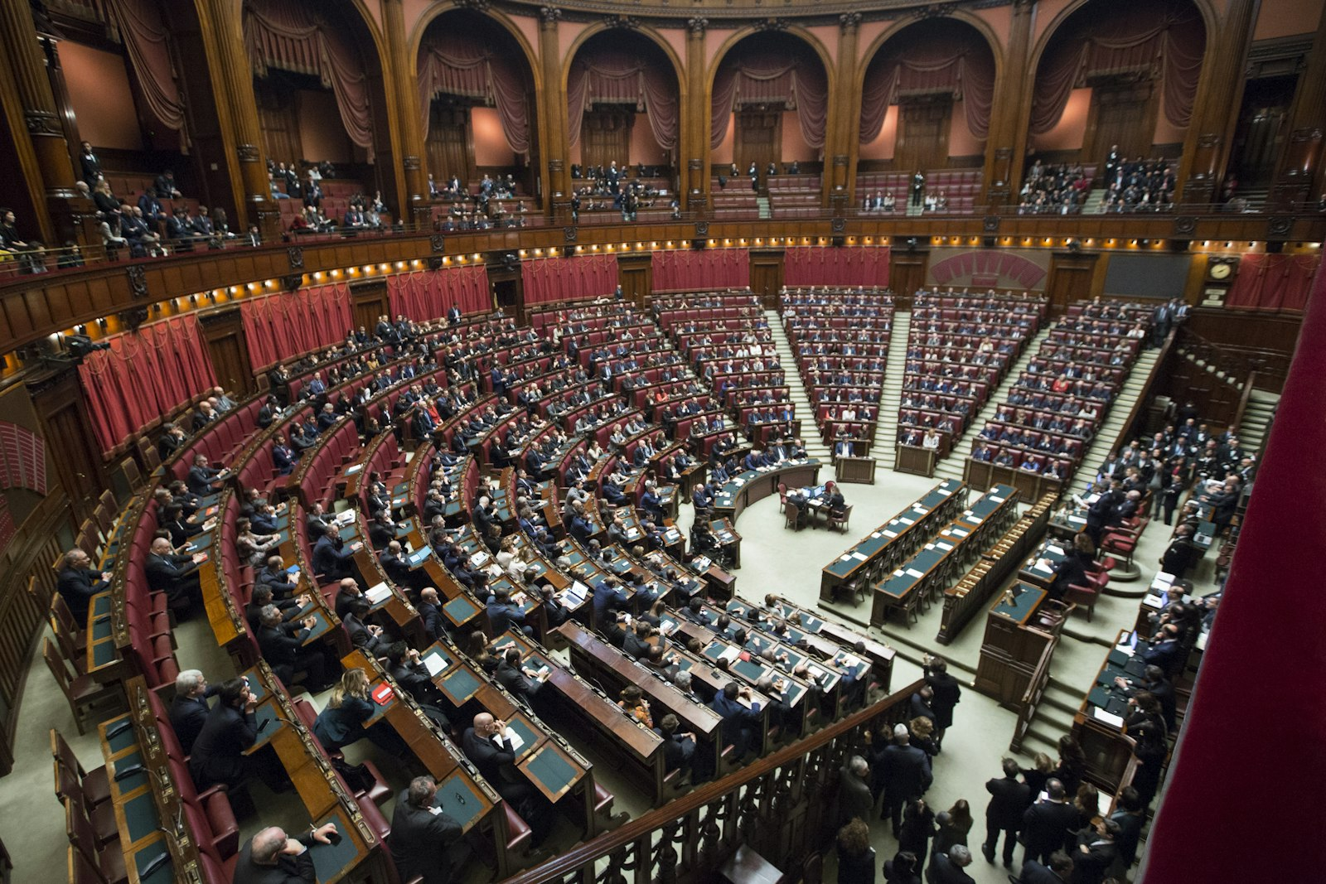
V. DEFENCE DIPLOMACY
Projecting Strategic Influence
The Office will lead Nigeria’s defence diplomacy by managing structured engagement with allied nations, regional partners and multilateral institutions.
Bilateral Engagements
Strategic dialogues with allied defence ministries
Multilateral Forums
AU, ECOWAS, UN & international security platforms
Defence Attachés
Coordinate posting, briefing and reporting
Treaty Negotiation
Lead and oversee defence cooperation agreements
OFFICE OF DEFENCE STRATEGY • PRESIDENCY, FEDERAL REPUBLIC OF NIGERIA
07 / 14

Slide 8

VI. SECURITY COOPERATION
Joint Operations & Intelligence Frameworks
Joint Training Programmes
Coordinated capability and readiness development with allied forces.
Intelligence Sharing
Frameworks for actionable, secure exchange of strategic intelligence.
Counter-Terrorism
Aligned response architecture against regional and transnational threats.
Border & Maritime Security
Integrated approach to land, sea and aerial domain awareness.
Cyber Defence
Joint cyber posture, threat intelligence and incident response.
OFFICE OF DEFENCE STRATEGY • PRESIDENCY, FEDERAL REPUBLIC OF NIGERIA
08 / 14

Slide 9

VII. STRATEGIC INNOVATION
Emerging Technologies & Indigenous Capability
Driving the Next Generation
of Nigerian Defence Capability
Artificial Intelligence & autonomous systems
Advanced surveillance & ISR platforms
Cyber and electronic warfare capability
Domestic defence R&D and manufacturing
Technology transfer & joint ventures
OFFICE OF DEFENCE STRATEGY • PRESIDENCY, FEDERAL REPUBLIC OF NIGERIA
09 / 14

Slide 10

VIII. INTERNATIONAL PARTNERSHIPS
A Global Network for National Advantage
Trusted Partnerships. Tangible Outcomes.
The Office will cultivate a structured portfolio of international defence partnerships that translate diplomatic relationships into concrete capability, investment and intelligence outcomes for Nigeria.
Strategic Allies
Regional Partners
Long-term cooperation with major defence powers
AU & ECOWAS-aligned security initiatives
Industrial Partners
Multilateral Bodies
OEMs, defence primes and technology providers
UN, regional bodies and security alliances
OFFICE OF DEFENCE STRATEGY • PRESIDENCY, FEDERAL REPUBLIC OF NIGERIA
10 / 14

Slide 11

IX. DEFENCE INDUSTRIAL DEVELOPMENT
Building Indigenous Capacity
A coordinated national approach is required to transform Nigeria from a primary importer of defence systems into a credible regional producer of defence technology and equipment.
Local Manufacturing
Strengthen DICON and the wider defence industrial ecosystem.
Joint Ventures
Structured partnerships with global defence manufacturers.
Self-Reliance.
Sovereignty.
Strategic Depth.
R&D Investment
Funding pipelines for defence research and innovation.
Skilled Workforce
Specialist training, retention and technology absorption.
OFFICE OF DEFENCE STRATEGY • PRESIDENCY, FEDERAL REPUBLIC OF NIGERIA
11 / 14

Slide 12
X. GOVERNANCE & STRUCTURE
Reporting & Coordination Architecture
THE PRESIDENT
Federal Republic of Nigeria
OFFICE OF DEFENCE STRATEGY
Security Cooperation & International Partnerships
DIVISION
DIVISION
DIVISION
DIVISION
Defence Diplomacy
Security Cooperation
Strategic Innovation
Industrial Development
Lean, high-level coordinating architecture — designed for strategic agility, not bureaucratic expansion.
OFFICE OF DEFENCE STRATEGY • PRESIDENCY, FEDERAL REPUBLIC OF NIGERIA
12 / 14

Slide 13
XI. EXPECTED OUTCOMES
A Return on Strategic Investment
→
Strengthened ability to leverage international defence partnerships
→
Accelerated access to advanced and emerging defence technologies
→
Sustained promotion of indigenous defence industrial development
→
Enhanced regional and global security cooperation
→
Reinforced Nigerian leadership on continental security matters
→
Direct support to the Presidential vision of a secure, prosperous Nigeria
OFFICE OF DEFENCE STRATEGY • PRESIDENCY, FEDERAL REPUBLIC OF NIGERIA
13 / 14

Slide 14

XII. APPROVAL
Approval is Respectfully Sought
Accordingly, approval is respectfully sought for the establishment of the Office of Defence Strategy, Security Cooperation and International Defence Partnerships under the Presidency of the Federal Republic of Nigeria.
SUBMITTED FOR PRESIDENTIAL CONSIDERATION
The Presidency • Federal Republic of Nigeria
CONFIDENTIAL

